Slide 1
Logic Concepts
Lecture Module 11

Slide 2
Objective
Logic Concepts
Equivalence Laws
Propositional Logic
Natural deduction method
Axiomatic System
Semantic Tableaux System
Resolution Refutation Method

Slide 3
Propositional Logic Concepts
Logic is a study of principles used to
  distinguish correct from incorrect reasoning.
Formally it deals with
  the notion of truth in an abstract sense and is concerned with the principles of valid inferencing.
A proposition in logic is a declarative statements which are either true or false (but not both) in a given context. For example,
  “Jack is a male”,
  "Jack loves Mary" etc.

Slide 4
Cont..
Given some propositions to be true in a given context,
  logic helps in inferencing new proposition, which is also true in the same context.
Suppose we are given a set of propositions such as
  “It is hot today" and
  “If it is hot it will rain", then
  we can infer that
    “It will rain today".

Slide 5
Well-formed formula
Propositional Calculus (PC) is a language of propositions basically refers
  to set of rules used to combine the propositions to form compound propositions using logical operators often called connectives such as Λ, V, ~, →, ↔
Well-formed formula is defined as:
  An atom is a well-formed formula.
  If α is a well-formed formula, then ~α is a well-formed formula.
  If α and β are well formed formulae, then (α Λ β), (α V β ), (α → β), (α ↔ β ) are also well-formed formulae.
  A propositional expression is a well-formed formula if and only if it can be obtained by using above conditions.

Slide 6
Truth Table
Truth table gives us operational definitions of important logical operators.
  By using truth table, the truth values of well-formed formulae are calculated.
Truth table elaborates all possible truth values of a formula.
The meanings of the logical operators are given by the following truth table.
P Q ~P P Λ Q P V Q P → Q P ↔ Q
T T F T T T T
T F F F T F F
F T T F T T F
F F T F F T T

Slide 7
Equivalence Laws
Commutation
1. P Λ Q ≅ Q Λ P
2. P V Q ≅ Q V P
Association
1. P Λ (Q Λ R) ≅ (P Λ Q) Λ R
2. P V (Q V R) ≅ (P V Q) V R
Double Negation
~ (~ P) ≅ P
Distributive Laws
1. P Λ ( Q V R) ≅ (P Λ Q) V (P Λ R)
2. P V ( Q Λ R) ≅ (P V Q) Λ (P V R)
De Morgan’s Laws
1. ~ (P Λ Q) ≅ ~ P V ~ Q
2. ~ (P V Q) ≅ ~ P Λ ~ Q
Law of Excluded Middle
P V ~ P ≅ T (true)
Law of Contradiction
P Λ ~ P ≅ F (false)

Slide 8
Propositional Logic - PL
PL deals with
  the validity, satisfiability and unsatisfiability of a formula
  derivation of a new formula using equivalence laws.
Each row of a truth table for a given formula is called its interpretation under which a formula can be true or false.
A formula α is called tautology if and only
  if α is true for all interpretations.
A formula α is also called valid if and only if
  it is a tautology.

Slide 9
Cont..
Let α be a formula and if there exist at least one interpretation for which α is true,
  then α is said to be consistent (satisfiable) i.e., if ∃ a model for α, then α is said to be consistent .
A formula α is said to be inconsistent (unsatisfiable), if and only if
  α is always false under all interpretations.
We can translate
  simple declarative and
  conditional (if .. then) natural language sentences into its corresponding propositional formulae.

Slide 10
Example
Show that " It is humid today and if it is humid then it will rain so it will rain today" is a valid argument.
Solution: Let us symbolize English sentences by propositional atoms as follows:
A : It is humid
B : It will rain
Formula corresponding to a text:
α : ((A → B) Λ A) → B
Using truth table approach, one can see that α is true under all four interpretations and hence is valid argument.

Slide 11
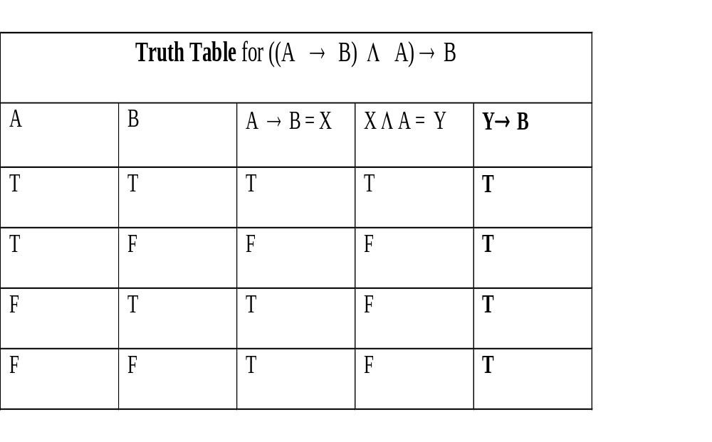
Cont..

Slide 12
Cont…
Truth table method for problem solving is
  simple and straightforward and
  very good at presenting a survey of all the truth possibilities in a given situation.
It is an easy method to evaluate
  a consistency, inconsistency or validity of a formula, but the size of truth table grows exponentially.
  Truth table method is good for small values of n.
For example, if a formula contains n atoms, then the truth table will contain 2^{n} entries.
  A formula α : (P Λ Q Λ R) → ( Q V S) is valid can be proved using truth table.
  A table of 16 rows is constructed and the truth values of α are computed.
  Since the truth value of α is true under all 16 interpretations, it is valid.

Slide 13
Cont..
We notice that if P Λ Q Λ R is false, then α is true because of the definition of →.
Since P Λ Q Λ R is false for 14 entries out of 16, we are left only with two entries to be tested for which α is true.
  So in order to prove the validity of a formula, all the entries in the truth table may not be relevant.
Other methods which are concerned with proofs and deductions of logical formula are as follows:
  Natural Deductive System
  Axiomatic System
  Semantic Tableaux Method
  Resolution Refutation Method

Slide 14
Natural deduction method - ND
ND is based on the set of few deductive inference rules.
The name natural deductive system is given because it mimics the pattern of natural reasoning.
It has about 10 deductive inference rules.
Conventions:
  E for Elimination.
  I for Introducing.
  P, P_{k} , (1 ≤ k ≤ n) are atoms.
  α_{k}, (1 ≤ k ≤ n) and β are formulae.

Slide 15
ND Rules
Rule 1: I-Λ (Introducing Λ)
I-Λ : If P₁, P₂, …, P_{n} then P₁ Λ P₂ Λ …Λ P_{n}
Interpretation: If we have hypothesized or proved P₁, P₂, … and P_{n} , then their conjunction P₁ Λ P₂ Λ …Λ P_{n} is also proved or derived.
Rule 2: E-Λ ( Eliminating Λ)
E-Λ : If P₁ Λ P₂ Λ …Λ P_{n} then P_{i} ( 1 ≤ i ≤ n)
Interpretation: If we have proved P₁ Λ P₂ Λ …Λ P_{n} , then some P_{i} is also proved or derived. This rule shows that Λ can be eliminated to yield one of its conjuncts.
Rule 3: I-V (Introducing V)
I-V : If P_{i} ( 1 ≤ i ≤ n) then P₁V P₂ V …V P_{n}
Interpretation: If some Pi (1≤ i ≤ n) is proved, then P₁V …V P_{n} is also proved.
Rule 4: E-V ( Eliminating V)
E-V : If P₁ V … V P_{n}, P₁ → P, … , P_{n} → P then P
Interpretation: If P₁ V … V P_{n}, P₁ → P, … , and P_{n} → P are proved, then P is proved.

Slide 16
Rules – cont..
Rule 5: I- → (Introducing → )
I- → : If from α₁, …, α_{n} infer β is proved then α₁ Λ … Λα_{n} → β is proved
Interpretation: If given α₁, α₂, …and α_{n} to be proved and from these we deduce β then α₁ Λ α₂ Λ… Λα_{n} → β is also proved.
Rule 6: E- → (Eliminating → ) - Modus Ponen
E- → : If P₁ → P, P₁ then P
Rule 7: I- ↔ (Introducing ↔ )
I- ↔ : If P₁ → P₂, P₂ → P₁ then P₁ ↔ P₂
Rule 8: E- ↔ (Elimination ↔ )
E- ↔ : If P₁ ↔ P₂ then P₁ → P₂ , P₂ → P₁
Rule 9: I- ~ (Introducing ~)
I- ~ : If from P infer P₁ Λ ~ P₁ is proved then ~P is proved
Rule 10: E- ~ (Eliminating ~)
E- ~ : If from ~ P infer P₁ Λ ~ P₁ is proved then P is proved

Slide 17
Cont..
If a formula β is derived / proved from a set of premises / hypotheses { α₁,…, α_{n} },
  then one can write it as from α₁, …, α_{n} infer β.
In natural deductive system,
  a theorem to be proved should have a form from α₁, …, α_{n} infer β.
Theorem infer β means that
  there are no premises and β is true under all interpretations i.e., β is valid.
If we assume that α → β is a premise, then we conclude that β is proved if α is given i.e.,
  if ‘from α infer β’ is a theorem then α → β is concluded.
  The converse of this is also true.
Deduction Theorem: To prove a formula α₁ Λ α₂ Λ… Λ α_{n} → β, it is sufficient to prove a theorem from α₁, α₂, …, α_{n} infer β.

Slide 18
Examples
Example1: Prove that PΛ(QVR) follows from PΛQ
Solution: This problem is restated in natural deductive system as "from P ΛQ infer P Λ (Q V R)". The formal proof is given as follows:
{Theorem} from P ΛQ infer P Λ (Q V R)
{ premise} P Λ Q (1)
{ E-Λ , (1)} P (2)
{ E-Λ , (1)} Q (3)
{ I-V , (3) } Q V R (4)
{ I-Λ, ( 2, 4)} P Λ (Q V R) Conclusion

Slide 19
Cont..
Example2: Prove the following theorem:
infer ((Q → P) Λ (Q → R)) → (Q → (P Λ R))
Solution:
In order to prove infer ((Q → P) Λ(Q → R)) → (Q → (P Λ R)), prove a theorem from {Q → P, Q → R} infer Q → (P Λ R).
Further, to prove Q → (P Λ R), prove a sub theorem from Q infer PΛ R
{Theorem} from Q → P, Q → R infer Q → (P Λ R)
{ premise 1} Q → P (1)
{ premise 2} Q → R (2)
{ sub theorem} from Q infer P Λ R (3)
{ premise } Q (3.1)
{ E- → , (1, 3.1) } P (3.2)
{E- →, (2, 3.1) } R (3.3)
{ I-Λ, (3.2,3.3) } P Λ R (3.4)
{ I- →, ( 3 )} Q → (P Λ R) Conclusion

Slide 20
Axiomatic System for PL
It is based on the set of only three axioms and one rule of deduction.
  It is minimal in structure but as powerful as the truth table and natural deduction approaches.
  The proofs of the theorems are often difficult and require a guess in selection of appropriate axiom(s) and rules.
  These methods basically require forward chaining strategy where we start with the given hypotheses and prove the goal.
  Only two operators → and ~ are used which are sufficient to model other remaining operators.
Example:
A V B ≅ ~ A → B
A Λ B ≅ ~ ( A → ~B)
A ↔ B ≅ ~ [(A → B) → ~(B → A)]

Slide 21
Contd
In Axiomatic System, there are three axioms and one rule.
Axiom1 (A1): α → (β → α)
Axiom2 (A2): (α →(β→γ)) →((α → β) → (α → γ))
Axiom3 (A3): (~ α → ~ β) → ( β → α)
Modus Ponen (MP) defined as follows:
Hypotheses: α → β and α Consequent: β

Slide 22
Contd.
Definition: If ∑ is a set of hypotheses involved in the deduction of α, then α is called to be a deductive consequence of ∑ or α is deducible from ∑ . It is written as ∑ |- α.
Definition: If ∑ is an empty set and α is deduced, then we write |- α. In this case α is deduced from axioms only and no hypotheses are used. In such case we call α to be a theorem.
Instances of the axioms are the simplest forms of theorems in Axiomatic Theory.

Slide 23
Contd…
It should be noted that proofs need not be unique.
Select axioms carefully which can lead to the proof.
The proof of a theorem can be tricky and hard.
The proofs require mixture of bottom up and top down reasoning.
Start reasoning bottom up seeing what we can do with axioms and top down reasoning seeing what might possibly lead to answer.

Slide 24
Examples
Examples: Establish the following:
1. {Q} |- (P→Q) i.e., P→ Q is a deductive consequence of {Q}.
{Hypothesis} Q (1)
{Axiom A1} Q → (P → Q) (2)
{MP, (1,2)} P → Q proved
2. { P → Q, Q → R } |- ( P → R ) i.e., P → R is a deductive consequence of { P → Q, Q → R }.
{Hypothesis1} P → Q (1)
{Hypothesis2} Q → R (2)
{Axiom A1} (Q→ R) → (P → (Q → R)) (3)
{MP, (2, 3)} P → (Q → R) (4)
{Axiom A2} (P → (Q → R)) →
((P → Q) → (P → R)) (5)
{MP , (4, 5)} (P → Q) → (P → R) (6)
{MP, (1, 6)} P → R proved

Slide 25
Deduction Theorems in AS
Deduction Theorem:
If ∑ is a set of hypotheses and α and β are well-formed formulae , then {∑ ∪ α } |- β implies ∑ |- (α → β ).
Converse of deduction theorem:
Given ∑ |- (α → β ),
we can prove { ∑ ∪ α } |- β.

Slide 26
Useful Tips
1. Given α, we can easily prove β → α for any well-formed formulae α and β.
2. If α → β is to be proved, then include α in the set of hypotheses ∑ and derive β from the set {∑ ∪ α}. Then using deduction theorem, we conclude α → β.
Example:
Prove ~ P → (P → Q) using deduction theorem.
Proof: Prove {~ P} |- (P → Q) and
|- ~ P→ (P→Q) follows from deduction theorem.

